Slide 1
Homomorphic Cryptography: Matrix Multiplication
Mamanchuk Mykola
ID: 202258010

Slide 2
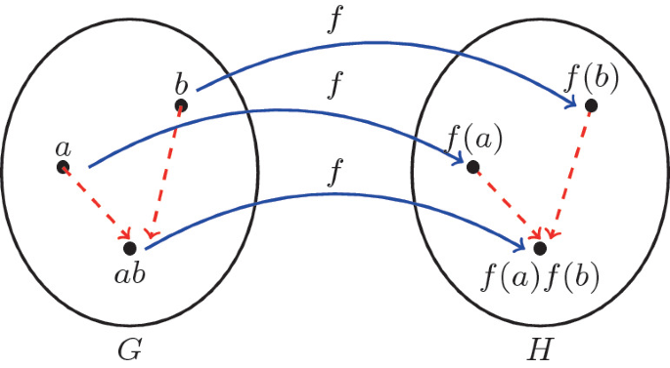
Recap regarding Homomorphic Encryption HE is a unique class of encryption methods that enables computations to be performed directly on encrypted data, without requiring any decryption process. The results of such computations remain encrypted, and when decrypted, they match the results of the same operations performed on the original, unencrypted data. Mathematically, having a plaintext space P and ciphertext space C, an encryption function E: P → C, a decryption function D: C → P, and an operation ⊕ in both P and C that you want to preserve, a homomorphic encryption scheme ensures that, for all m₁, m₂ in P, D: (E(m₁) ⊕ E(m₂)) = m₁ ⊕ m₂.
Def <=> $∀ m₁, m₂∈P: D\left(E\left(m₁\right) ⊕ E\left(m₂\right)\right) = m₁ ⊕ m₂$
$$∀a,b∈R∈F: ∃E\left(a\right),E\left(b\right)∈R^{∗}∈\tilde{F}: D\left(E\left(a\right) ⊕ E\left(b\right)\right) =a∙b$$

Slide 3
Justifications and introduction to Matrix Multiplication in HE
Homomorphically encrypted data presents unique challenges in computations, particularly for operations like matrix multiplication.
Traditional matrix multiplication methods don't suffice due to data privacy needs and encryption complexities.
Encrypted data elements require specialized algorithms for processing, as they cannot be dealt with in the same manner as unencrypted data.
The necessity for computational efficiency adds another layer of complexity.
Directly applying conventional algorithms on encrypted data could significantly increase computational load and processing time, making it impractical in many scenarios.
The proposed solution optimizes resource usage by utilizing idle ciphertext slots and performing a single ciphertext-ciphertext multiplication.
Maintaining data privacy during computation is crucial - conventional methods could unintentionally expose data patterns or sensitive information i.e. irregular noise management.
The methodology introduced in this study ensures secure computation while preserving data privacy, making it suitable for matrix multiplication on homomorphically encrypted data.

Slide 4
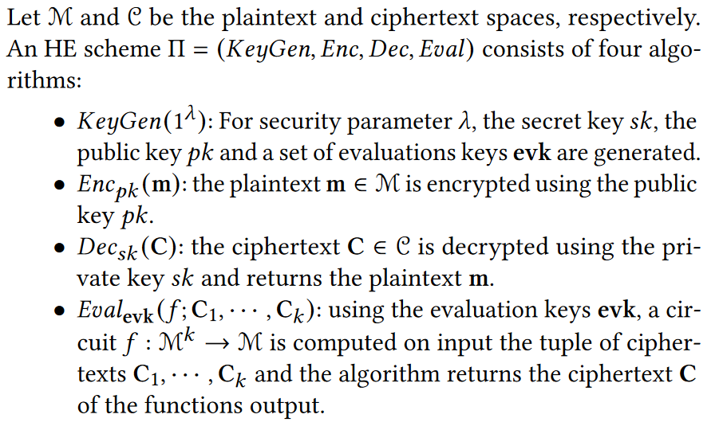
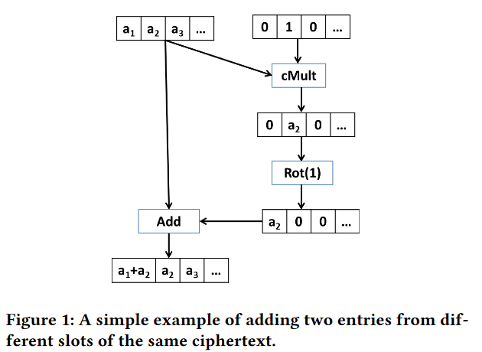
CKKS Scheme essentials with HE
Definitions
2. Masking of CT

Slide 5
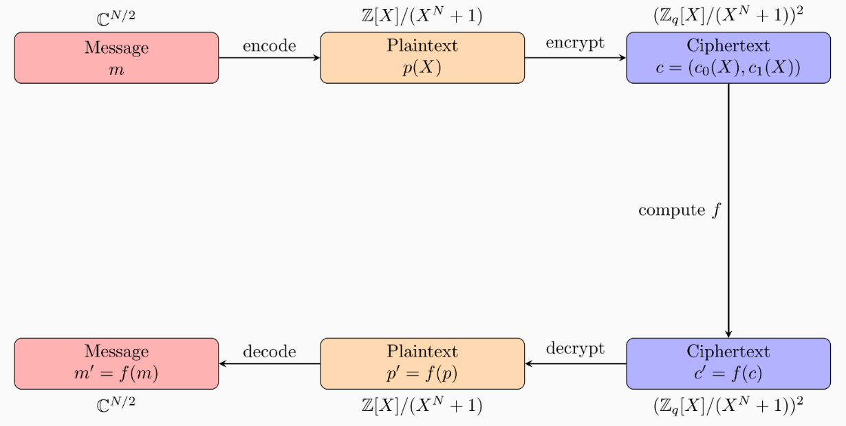
CKKS Scheme
The CKKS scheme encrypts a vector of values (message m) into a ciphertext using a public key. This process involves encoding the message into a plaintext polynomial.
Polynomials are used due to their balance of security and efficiency compared to typical vector computations.
Once the message is encrypted, CKKS allows addition, multiplication, and rotation operations to be performed on the ciphertext.
The decrypted result of any homomorphic operation performed on the ciphertext, when decoded, yields the same result as if the operation was performed on the original plaintext message.
Implementing a homomorphic encryption scheme involves integrating homomorphic properties into encoding, decoding, encryption, and decryption processes.

Slide 6
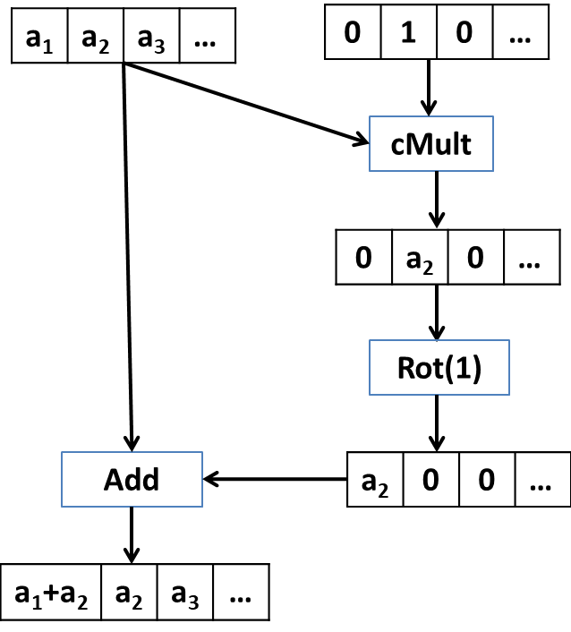
Plaintext packing / encoding
Plaintext packing is a feature in homomorphic encryption schemes that enhances performance by storing multiple messages within a single plaintext. This effectively allows a plaintext (and its corresponding ciphertext) to be treated as a vector with each message in a slot.
Operations on these vectors are performed component-wise (Single Instruction Multiple Data - SIMD) on the slots of the ciphertexts or a mixture of plaintext and ciphertext.
Challenges with plaintext packing include the inability to access specific slots directly or to transfer data between slots due to the constraints of data manipulation and encryption.
To navigate these challenges, two main operations are used: the cyclic rotation of slots (Rot) and scalar (plaintext) multiplication (cMult).
Figure 1: A simple example of adding two entries from different slots of the same ciphertext.

Slide 7
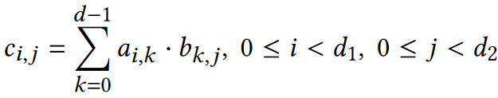



Matrix Notations
Let 𝐴 and 𝐵 be two matrices of size (𝑑₁ ×𝑑) and (𝑑 ×𝑑₂), respectively.
The product 𝐶 = 𝐴 · 𝐵 has size (𝑑₁ × 𝑑₂) and it is given by:
For 0 ≤ 𝑘 < 𝑑, (𝑑₁ × 𝑑₂) matrices are defined as:
such that and the (𝑑₁ × 𝑑₂) matrices ${\hat{B}}_{k}$ is defined as:
where:

Slide 8
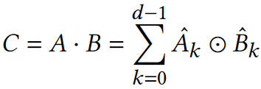
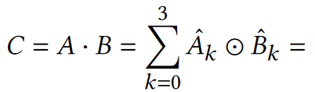
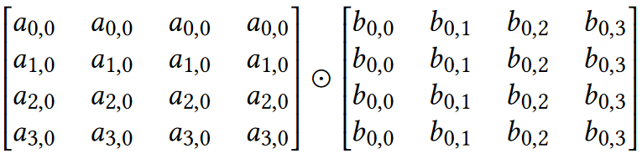
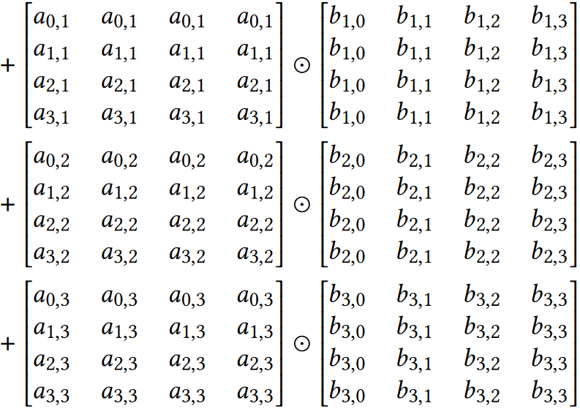
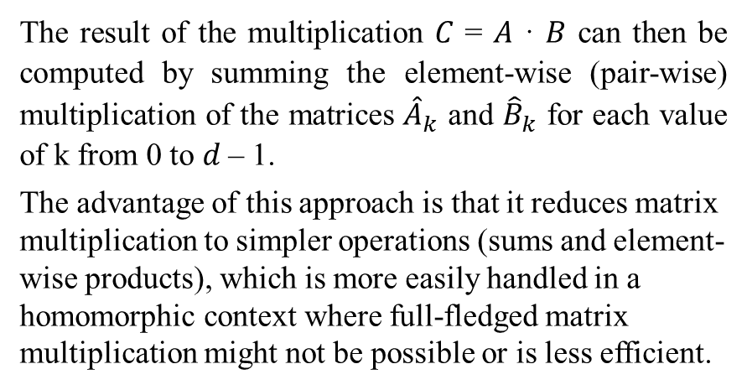
Notations and computation
This way the matrix ${\hat{A}}_{k}$ is computed by horizontally concatenating 𝑑₂ times the 𝑘-th column of 𝐴, while ${\hat{B}}_{k}$ is the computed by vertically concatenating 𝑑₁ times the 𝑘-th row of 𝐵. Thus, from (1), the product 𝐶 can be computed as:
Example 1. Let 𝑑₁ = 𝑑 = 𝑑₂ = 4. Then:
The result of the multiplication 𝐶 = 𝐴 · 𝐵 can then be computed by summing the element-wise (pair-wise) multiplication of the matrices ${\hat{A}}_{k}$ and ${\hat{B}}_{k}$ for each value of k from 0 to 𝑑 – 1.
The advantage of this approach is that it reduces matrix multiplication to simpler operations (sums and element-wise products), which is more easily handled in a homomorphic context where full-fledged matrix multiplication might not be possible or is less efficient.

Slide 9
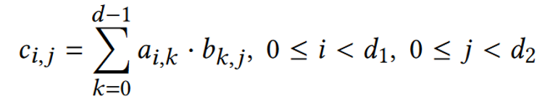

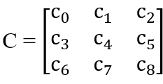

Mapping and data transformation
Plaintext encoding is crucial for maintaining a consistent representation of input matrices A, B, and output C in homomorphic encryption. This consistency simplifies the task for developers, as they only need to manage one matrix representation. The proposed solution leverages the row ordering encoding map from the referenced literature.
This encoding map, denoted as 𝜉, transforms a vector C of size 𝑑² in ring R into a (𝑑 × 𝑑) square matrix, where the vector C is the concatenation of the 𝑑 row vectors of the matrix.
In more detail, an element 𝐶𝑖,𝑗 of the matrix, where 0 ≤ 𝑖 < 𝑑 and 0 ≤ 𝑗 < 𝑑, is located at the (𝑖 · 𝑑 + 𝑗) slot of C. The ciphertext that encrypts the plaintext C (represented as 𝜉⁻¹(C)) is considered as the encryption of the message 𝐶.
For ease of reference, the matrix 𝐶 (message) is denoted by C, indicating the corresponding plaintext/ciphertext.
As an example, consider 𝑑 = 3 and a message C as a matrix (3,3). The message 𝐶 is transformed into a vector C using 𝜉⁻¹(). The first row of the message 𝐶 is mapped into the first 3 slots of the vector C, the second row into the next 3 slots, and so forth.
Example 2:

Slide 10
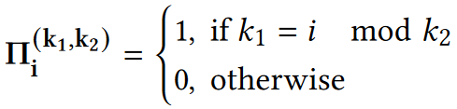
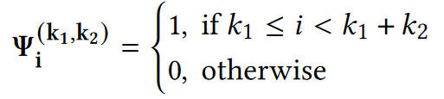
Row and column masking
Next are defined two binary vectors Π and Ψ that are used to manage rows and columns of a matrix using scalar multiplication. More precisely, the binary vector Π_{k1},_{k2} equals 1 in the slots with index of form 𝑘₁ + 𝑙·𝑘₂, for an integer 𝑙, while Ψ_{k1},_{k2} equals 1 in the slots with index from 𝑘₁ to 𝑘₁ + 𝑘₂ − 1. Both vectors are zero in all the other slots. More formally:
Afterward, let C be the ciphertext of a (𝑑 × 𝑑) matrix 𝐶.
Then, for 0 ≤ 𝑖 < 𝑑, the HE plaintext multiplication L_{i} = cMult(C, Π_{i,d}) returns a ciphertext L_{i} which has all slots equal to zero except the slots in positions (𝑖 + 𝑙·𝑑) that are equal to the corresponding C slots.
That is that, L_{i} is the encryption of the 𝑖-th column of 𝐶. Similarly, for 0 ≤ 𝑖 < 𝑑, R_{i} = cMult(C, Ψ_{i·d,d}) returns an all zero ciphertext R_{i} except for the slots [𝑖·𝑑] to [(𝑖 + 1) · 𝑑 – 1] that contain the 𝑖-th row of 𝐶.

Slide 11
Row and column masking [Example]
Following Example 2, the ciphertext L₀ = cMult(C, Π_{0,3}) is given by:
Where:
and
Next, regarding the row masks, for Ψ_{0,3}, we get R₀ = cMult(C, Ψ_{0,3}):
Where:

Slide 12
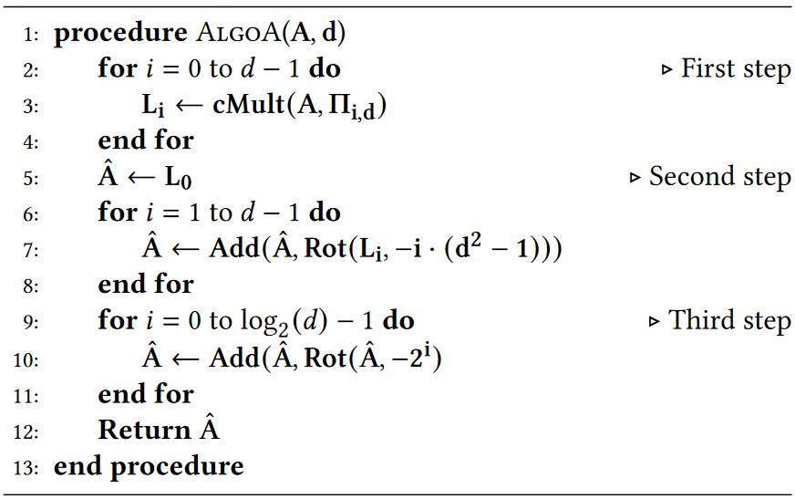

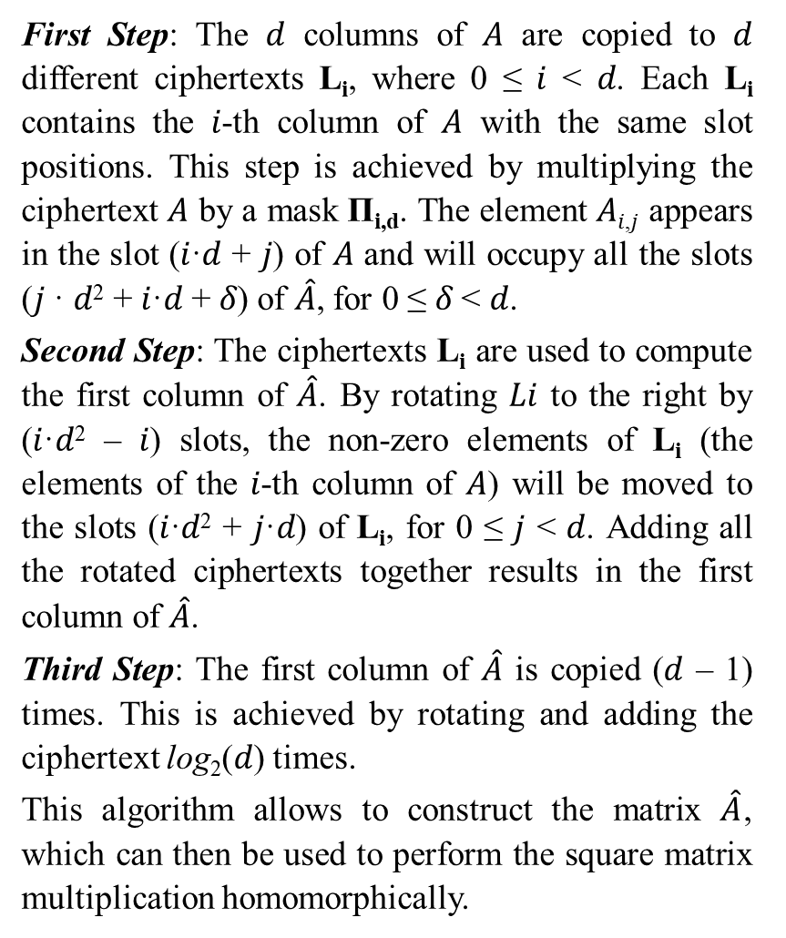
Matrix $\hat{A}$ computation algorithm
First Step: The 𝑑 columns of 𝐴 are copied to 𝑑 different ciphertexts L_{i}, where 0 ≤ 𝑖 < 𝑑. Each L_{i} contains the 𝑖-th column of 𝐴 with the same slot positions. This step is achieved by multiplying the ciphertext 𝐴 by a mask Π_{i,d}. The element 𝐴_{𝑖,𝑗} appears in the slot (𝑖·𝑑 + 𝑗) of 𝐴 and will occupy all the slots (𝑗 · 𝑑² + 𝑖·𝑑 + 𝛿) of $\hat{A}$, for 0 ≤ 𝛿 < 𝑑.
Second Step: The ciphertexts L_{i} are used to compute the first column of $\hat{A}$. By rotating 𝐿𝑖 to the right by (𝑖·𝑑² – 𝑖) slots, the non-zero elements of L_{i} (the elements of the 𝑖-th column of 𝐴) will be moved to the slots (𝑖·𝑑² + 𝑗·𝑑) of L_{i}, for 0 ≤ 𝑗 < 𝑑. Adding all the rotated ciphertexts together results in the first column of $\hat{A}$.
Third Step: The first column of $\hat{A}$ is copied (𝑑 – 1) times. This is achieved by rotating and adding the ciphertext log₂(𝑑) times.
This algorithm allows to construct the matrix $\hat{A}$, which can then be used to perform the square matrix multiplication homomorphically.
Input: matrix 𝐴 of size (𝑑 × 𝑑).
Output: matrix $\hat{A}$ of size (𝑑² × 𝑑).
Both matrices are encrypted homomorphically.
Algorithm 1. Computation of $\hat{A}$:

Slide 13
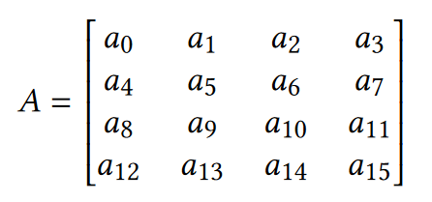
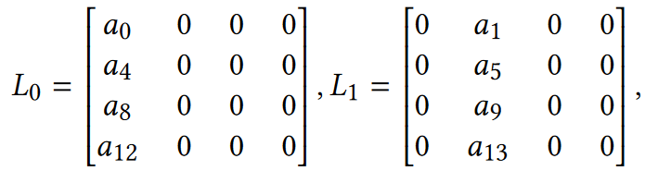
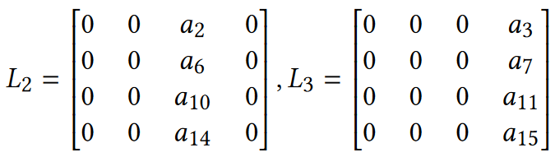
Matrix $\hat{A}$ computation example
Let’s assume that the matrix used as input in Algorithm 1 is:
After the First Step, the four matrices L_{i} are:
* The message representation, i.e. the data after applying the 𝜉⁻¹() transformation, and not the vector (plaintext encoding) representation is shown.

Slide 14
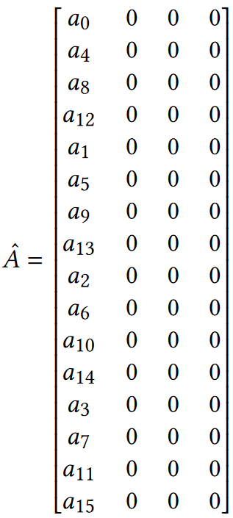
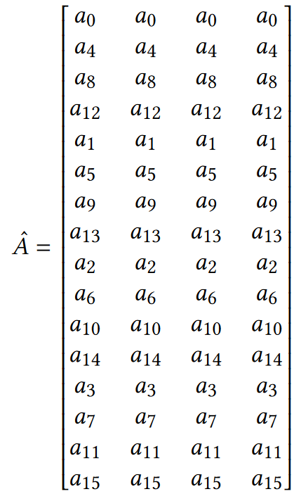
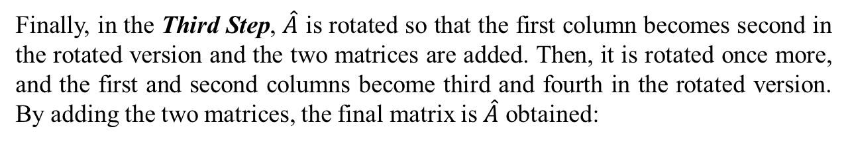
Matrix $\hat{A}$ computation example
In the Second Step, the four matrices are rotated and added to produce the matrix, so:
Finally, in the Third Step, $\hat{A}$ is rotated so that the first column becomes second in the rotated version and the two matrices are added. Then, it is rotated once more, and the first and second columns become third and fourth in the rotated version. By adding the two matrices, the final matrix is $\hat{A}$ obtained:
* The message representation, i.e. the data after applying the 𝜉⁻¹() transformation, and not the vector (plaintext encoding) representation is shown.

Slide 15


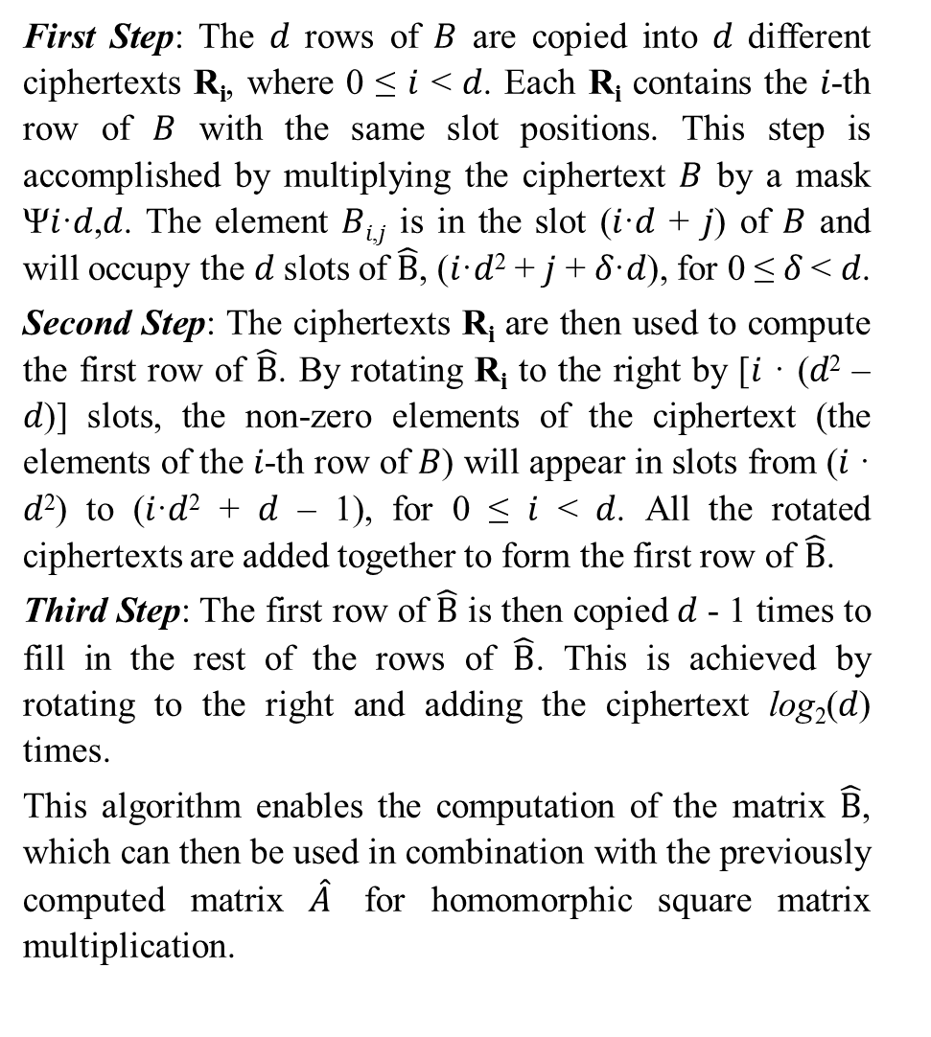
Matrix $\hat{B}$ computation algorithm
First Step: The 𝑑 rows of 𝐵 are copied into 𝑑 different ciphertexts R_{i}, where 0 ≤ 𝑖 < 𝑑. Each R_{i} contains the 𝑖-th row of 𝐵 with the same slot positions. This step is accomplished by multiplying the ciphertext 𝐵 by a mask Ψ𝑖·𝑑,𝑑. The element 𝐵_{𝑖,𝑗} is in the slot (𝑖·𝑑 + 𝑗) of 𝐵 and will occupy the 𝑑 slots of $\hat{B}$, (𝑖·𝑑² + 𝑗 + 𝛿·𝑑), for 0 ≤ 𝛿 < 𝑑.
Second Step: The ciphertexts R_{i} are then used to compute the first row of $\hat{B}$. By rotating R_{i} to the right by [𝑖 · (𝑑² – 𝑑)] slots, the non-zero elements of the ciphertext (the elements of the 𝑖-th row of 𝐵) will appear in slots from (𝑖 · 𝑑²) to (𝑖·𝑑² + 𝑑 – 1), for 0 ≤ 𝑖 < 𝑑. All the rotated ciphertexts are added together to form the first row of $\hat{B}$.
Third Step: The first row of $\hat{B}$ is then copied 𝑑 - 1 times to fill in the rest of the rows of $\hat{B}$. This is achieved by rotating to the right and adding the ciphertext log₂(𝑑) times.
This algorithm enables the computation of the matrix $\hat{B}$, which can then be used in combination with the previously computed matrix $\hat{A}$ for homomorphic square matrix multiplication.
Input: matrix B of size (𝑑 × 𝑑).
Output: matrix $\hat{B}$ of size (𝑑² × 𝑑).
Both matrices are encrypted homomorphically.
Algorithm 2. Computation of $\hat{B}$:

Slide 16
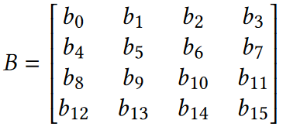
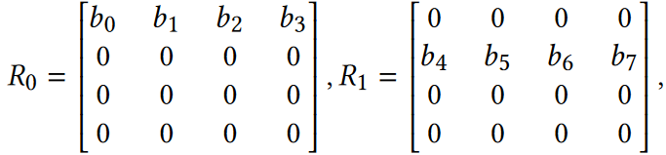
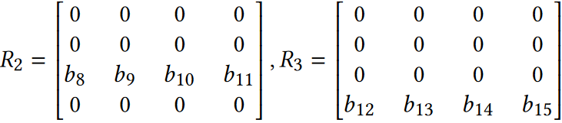
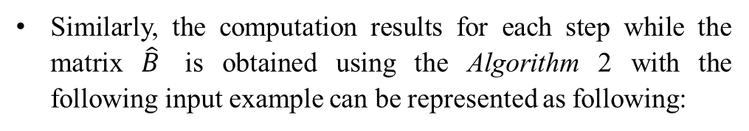
Matrix $\hat{B}$ computation example
Similarly, the computation results for each step while the matrix $\hat{B}$ is obtained using the Algorithm 2 with the following input example can be represented as following:
After the First Step, the four matrices R_{i} are:
* The message representation, i.e. the data after applying the 𝜉⁻¹() transformation, and not the vector (plaintext encoding) representation is shown.

Slide 17
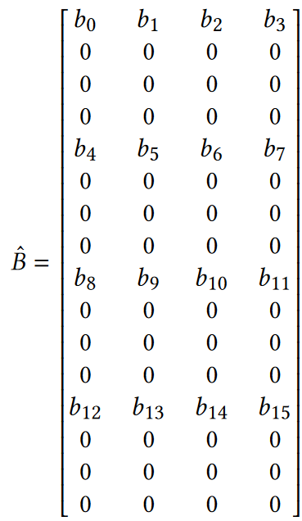
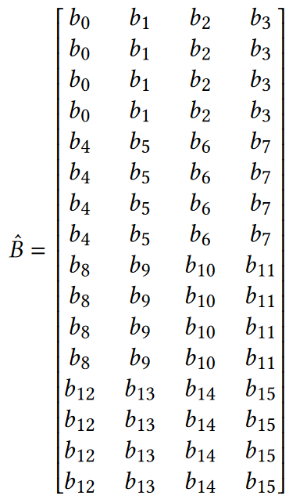
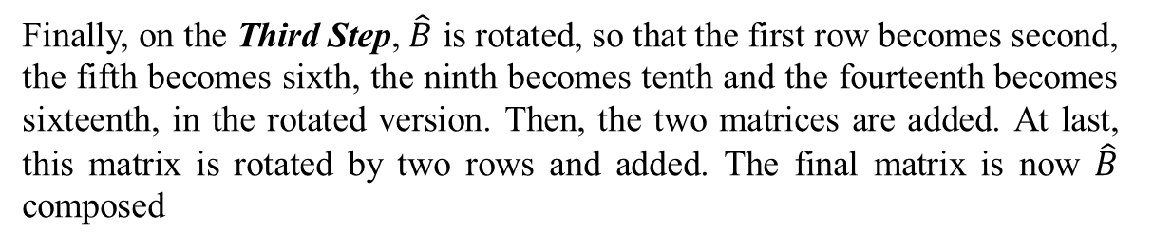
Matrix $\hat{B}$ computation example
During the Second Step, after rotations, the four matrices are added, to produce the following result:
Finally, on the Third Step, $\hat{B}$ is rotated, so that the first row becomes second, the fifth becomes sixth, the ninth becomes tenth and the fourteenth becomes sixteenth, in the rotated version. Then, the two matrices are added. At last, this matrix is rotated by two rows and added. The final matrix is now $\hat{B}$ composed
* The message representation, i.e. the data after applying the 𝜉⁻¹() transformation, and not the vector (plaintext encoding) representation is shown.

Slide 18
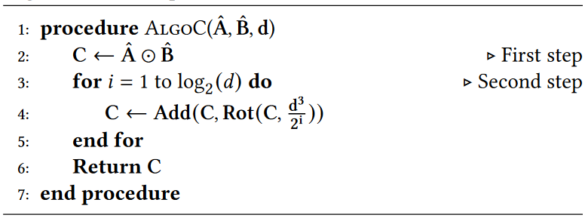
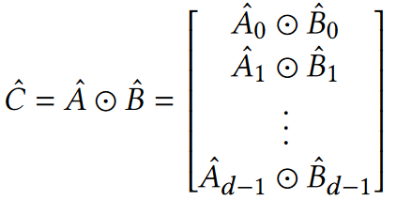

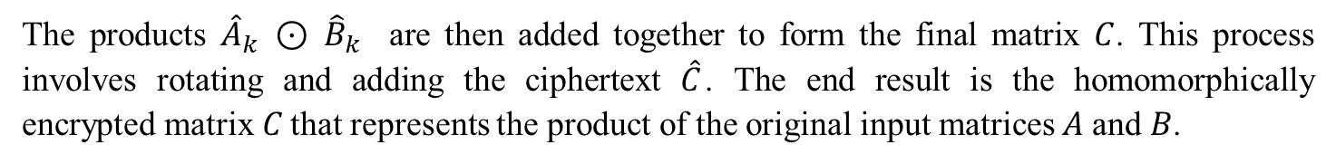
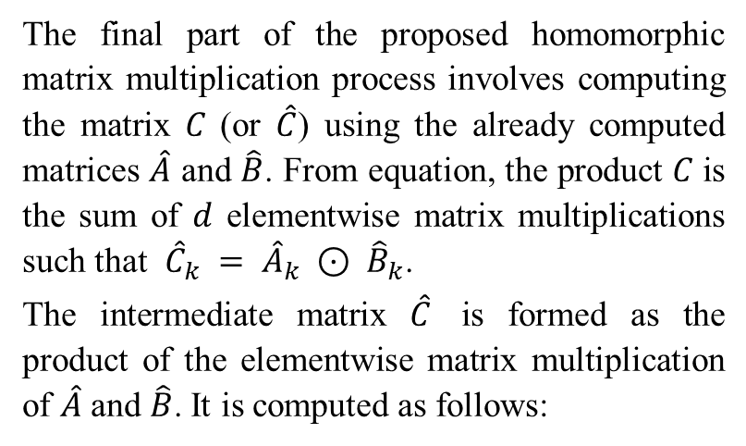
Product $\hat{C}$ computation algorithm
The final part of the proposed homomorphic matrix multiplication process involves computing the matrix 𝐶 (or $\hat{C}$) using the already computed matrices $\hat{A}$ and $\hat{B}$. From equation, the product 𝐶 is the sum of 𝑑 elementwise matrix multiplications such that ${\hat{C}}_{k} = {\hat{A}}_{k} ⊙ {\hat{B}}_{k}$.
The intermediate matrix $\hat{C}$ is formed as the product of the elementwise matrix multiplication of $\hat{A}$ and $\hat{B}$. It is computed as follows:
Input: matrix $\hat{A}$ of size (𝑑² × 𝑑), matrix $\hat{B}$ of size (𝑑² × 𝑑).
Output: matrix $\hat{C} = \hat{A} × \hat{B}$ of size (𝑑 × 𝑑).
Algorithm 3. Computation of $\hat{C}$:
The products ${\hat{A}}_{k} ⊙ {\hat{B}}_{k}$ are then added together to form the final matrix $C$. This process involves rotating and adding the ciphertext $\hat{C}$. The end result is the homomorphically encrypted matrix 𝐶 that represents the product of the original input matrices 𝐴 and 𝐵.

Slide 19
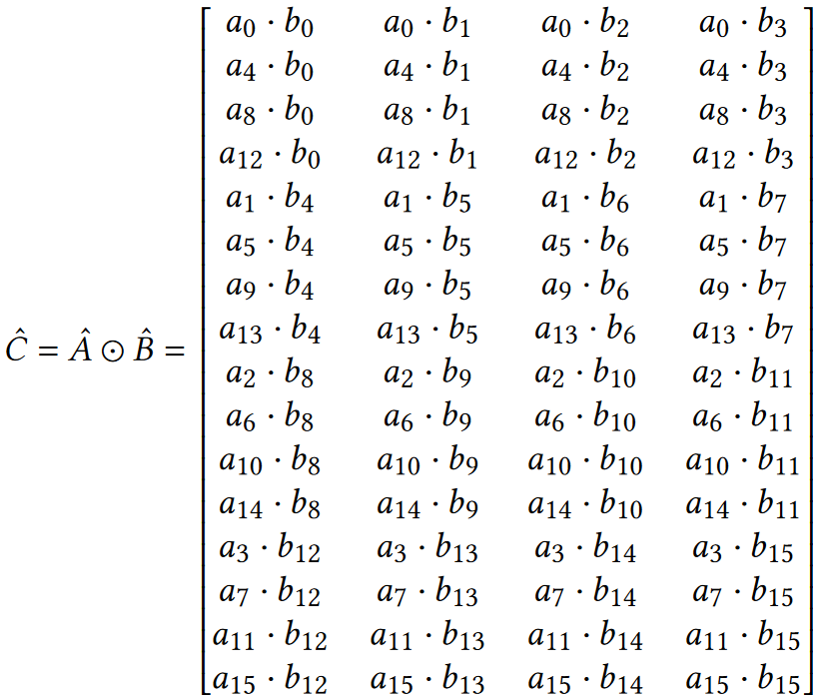
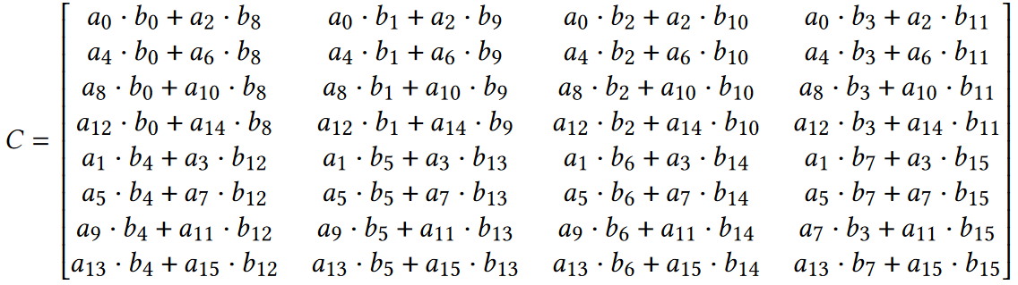
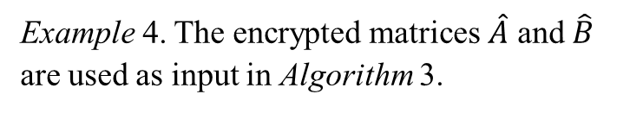
Matrix $\hat{C}$ computation example
Example 4. The encrypted matrices $\hat{A}$ and $\hat{B}$ are used as input in Algorithm 3.
The First Step computes the following $\hat{C}$:
During the Second Step, two rotations and additions are performed. After the first rotation and addition, 𝐶 appears in Table 2. A second rotation and addition compute the final 𝐶.
* The message representation, i.e. the data after applying the 𝜉⁻¹() transformation, and not the vector (plaintext encoding) representation is shown.

Slide 20
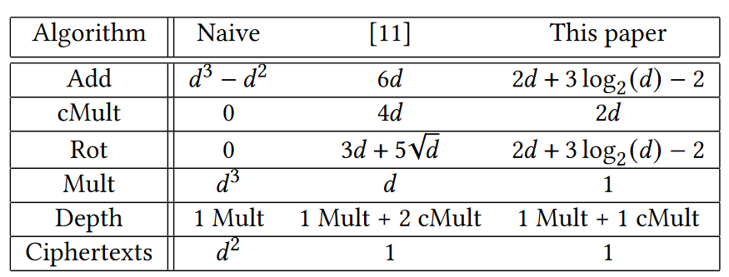
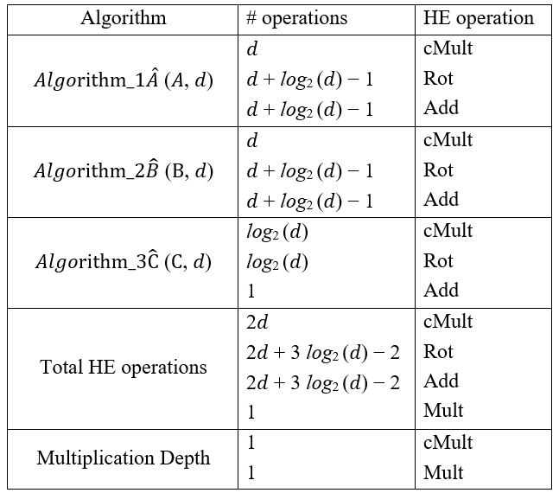
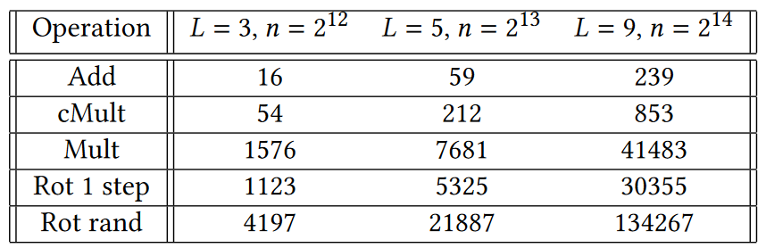
Complexity analysis and comparison
Table 2: Comparison of the computation complexities for various matrix multiplication solutions
Table 1: Illustration of computation complexity. The total number of HE operations and the multiplicative depth per algorithm
Table 3: Computation time regarding in 𝜇𝑠𝑒𝑐 regarding specific parameters and HE operations

